Slide 1
PowerPoint Slides for the YouTube Video about 3 100% Guaranteed Trading Strategies that Print Money
19 March 2025

Slide 2
Download my Free Tool
100% Guaranteed Trading strategies that print money

Slide 3
There is a downloadable PDF showing all the slides used in this video
The purpose of Trading is to
make Money

Slide 4
YET, VERY FEW TRADERS KNOW WHAT CAUSES ROBOTS OR STRATEGIES TO PRINT MONEY

Slide 5
There is a downloadable PDF showing all the slides used in this video
How can you aim for success if you don’t know what success looks like?
Some traders are lucky to find success by accident without realising why

Slide 6
There are only three things you need to manage to create 3 100% Guaranteed strategies.

Slide 7
1. The strategy you are using will have a success rate. The success rate is the number of successful trades compared to the total trades you have made
Example:
Since you opened your account, you have had 60 successful trades out of 100. Therefore, your success rate is 60% (60 divided by 100)

Slide 8
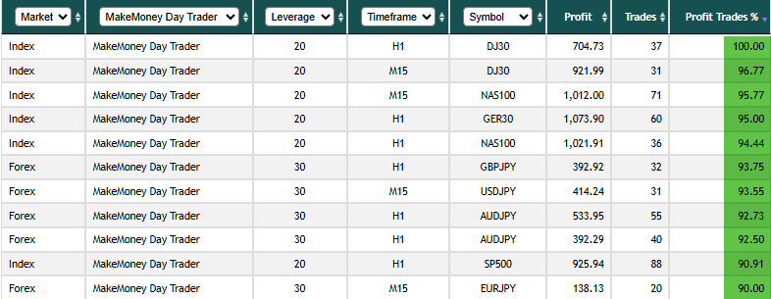
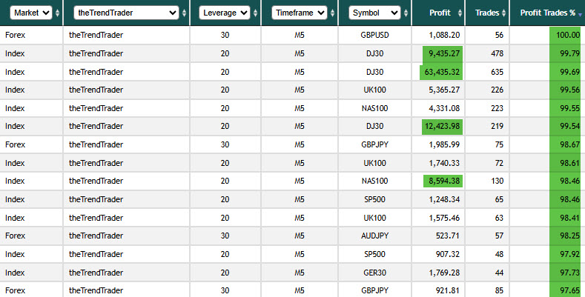

Slide 9
2 / 3. Next, we need to look at the average money you have made per successful deal and compare it with the average money you have lost per unsuccessful deal
Example: Looking at your account, the average gain per successful deal (60) was $12 per deal ($720 / 60). The average loss per negative deal (40) was $10 per deal ($400 / 40).

Slide 10
How much money did your account make?
60% of 100 (=60) x $12.00 = $720.00
40% of 100 (=40) x-$10.00 = -$400.00
Net gains = $320.00
Average gain per 100 trades = $3.20

Slide 11
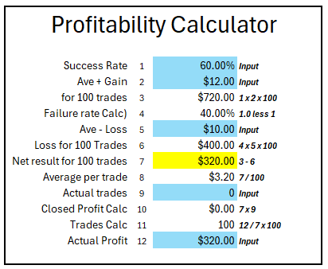
60% of 100 (=60) x $12.00 = $720.00
40% of 100 (=40) x-$10.00 = -$400.00
Net gains = $320.00
Average gain per 100 trades = $3.20

Slide 12
So, this shows one of the strategies that absolutely Guarantees success.
If your Success Rate is above 50% and your Average Gains are bigger than your average losses, you will
PRINT MONEY !!!

Slide 13
https://youtu.be/-lNTomKrebY?si=o2OBvq11xeSlCWnB

Slide 14
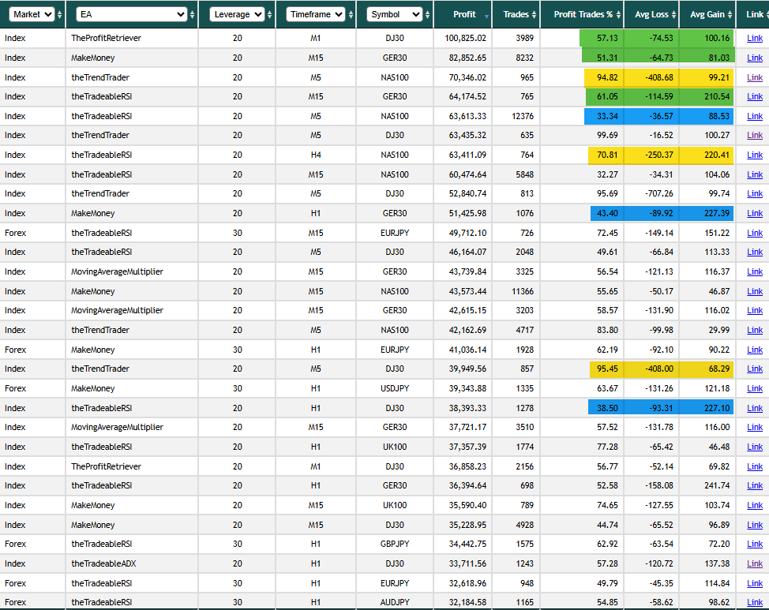
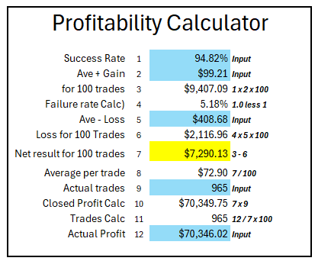

Slide 15
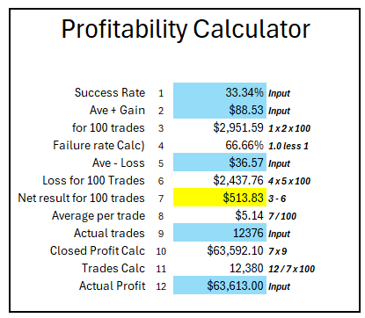

Slide 16
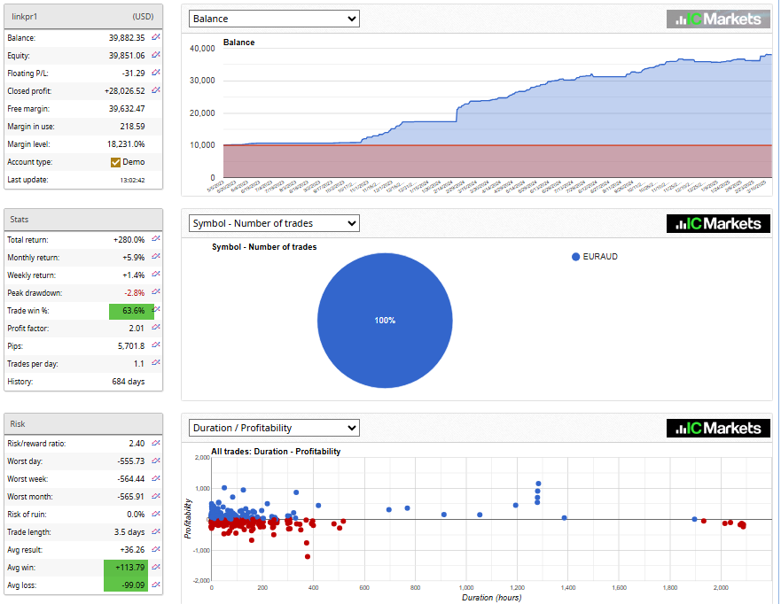
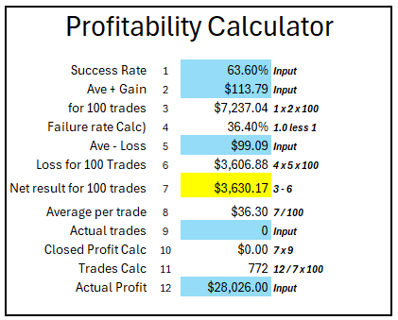

Slide 17
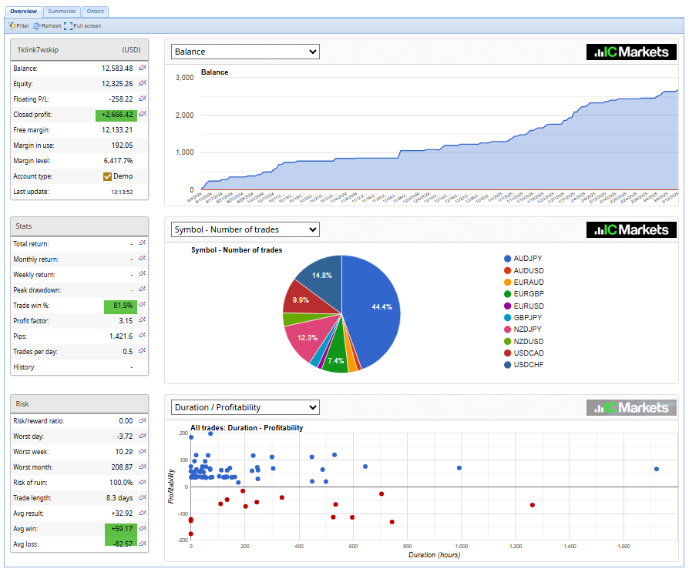
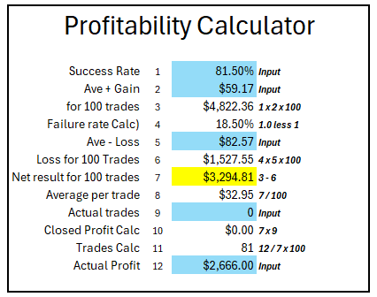

Slide 18
https://youtu.be/ueop6Y-qO78

Slide 19
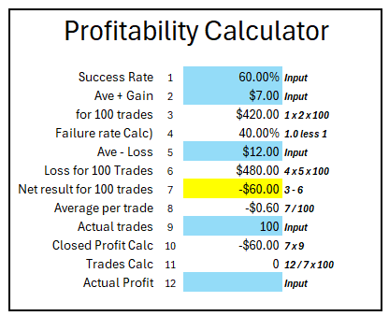
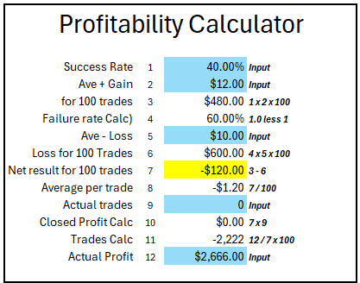
Loss despite a positive success rate
Loss despite a positive gain's ratio

Slide 20
Next Video:
How to improve your Success Rate and your Average gains vs. your average losses

Slide 21
Links showing aspects of what has been shown in the video:
Free Optimized settings: https://settings.eafactory.com/Expert4x/overview/
Link-2-Success Service: https://bestforexrobots.reviews/LinkingAccs
The Expert4x YouTube Channel: https://www.expert4x.com/youtubespecial/
Expert4x Trading Robots and discounted bundles: www.expert4x.com
Specialised paid Optimised settings: https://forextrading-alerts.com/
Paid Premium trading Forum: https://bestforexrobots.reviews/PremiumForum
Link your account to FXBlue: https://youtu.be/ueop6Y-qO78
Enter the WEEKLY $5K account competition HERE: https://bestforexrobots.reviews/45000PropTradingComp
Join our community of 30,000 traders:
https://expert4x.com/join-our-community-for-forex-traders/
Download the profitability model: https://expert4x.com/excel-profitability-calculator/

Slide 22
100% Guaranteed Trading strategies that print money

